Slide 1
Tic Tac Toe Game
Submitted by:
ANUSHI SHARMA (24BCS12976)
NISHU YADAV (24BCS12967)
MANYATA(24BCS12998)
Submitted to :
NAVJOT KAUR

Slide 2
Introduction
Tic Tac Toe is a 3x3 grid-based game played by two players.
Players take turns marking X or O on the board.
Goal: Form three matching symbols in a line.
This implementation uses Python in a console environment.
Demonstrates loops, lists, and conditionals.

Slide 3
Objectives
Develop an interactive console-based Python game.
Apply basic programming concepts: if-else, loops, lists, functions.
Validate winning and draw logic in gameplay.
Encourage structured and logical thinking.

Slide 4
Tools and Requirements
Language: Python
Editor: VS Code / IDLE / PyCharm
Platform: Any computer with Python 3 installed
Main Concepts Used:
  If-Else conditions
  While loops
  Functions
  Lists and strings

Slide 5
Problem Identification
Design a game where two players can play Tic Tac Toe.
The board should show after every move.
The game must check for a win or draw after each move.
Once finished, players can choose to play again.

Slide 6
Game Logic
The game board is made using a list of 9 positions (1–9).
Each player picks a position to place X or O.
After each move:
  The board updates.
  The program checks all winning combinations.
If no one wins and all boxes are filled → Draw message is shown.

Slide 7
Important Functions
display_board(): Prints the 3x3 board.
player_input(): Takes symbol choice (X or O).
check_win(): Checks for 3 same symbols in a line.
check_draw(): Checks if all boxes are filled.
main(): Controls the whole game flow.

Slide 8
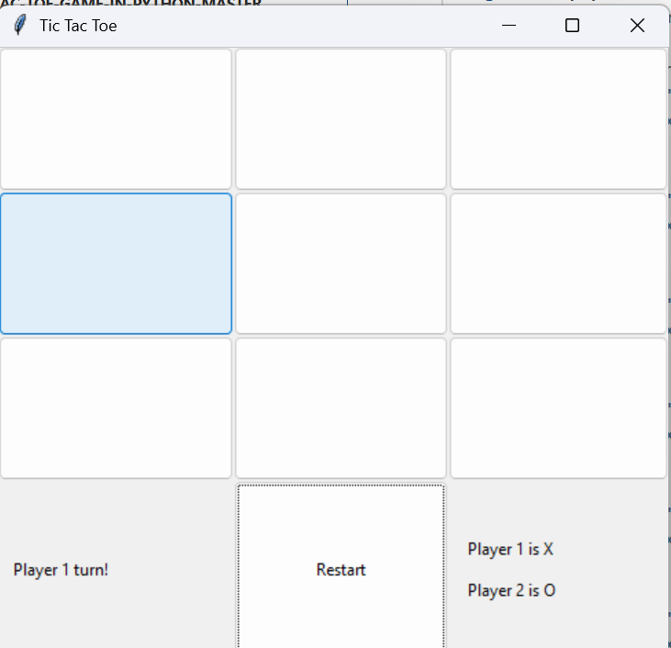
Output
The output is shown in the terminal window.
Players enter numbers (1–9) for their move.
The game board updates each time.
Messages like:
  “Player X wins!”
  “Player O wins!”
  “It’s a Draw!”

Slide 9
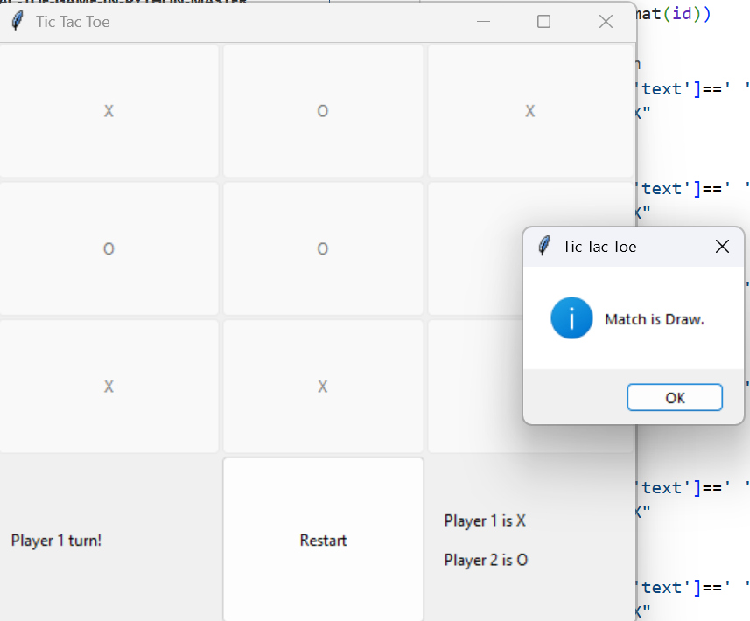

Slide 10
Challenges and Learnings
Challenges Faced:
Handling wrong inputs.
Checking all winning cases correctly.
Designing the board neatly in text form.
Learnings:
Understood Python functions and loops.
Improved debugging and logic building.
Learned to make a fully working small project.

Slide 11
Conclusion and Future Work
The Tic Tac Toe project helped me learn how to build a complete game using Python.
It improved my coding logic and creativity.
Future Ideas:
  Add single-player mode (computer vs player).
  Create GUI using Tkinter or Pygame.
  Add score tracking and sound effects.

Slide 12
THANK YOU

